Slide 1
W3.org links
Main website → https://www.w3.org/
WCAG → Accessibility →Standards/Guidelines → Updates
WCAG → Accessibility → Teach and Advocate → Make Presentations and Meetings Accessible (Basics & During the Presentation)

Slide 2
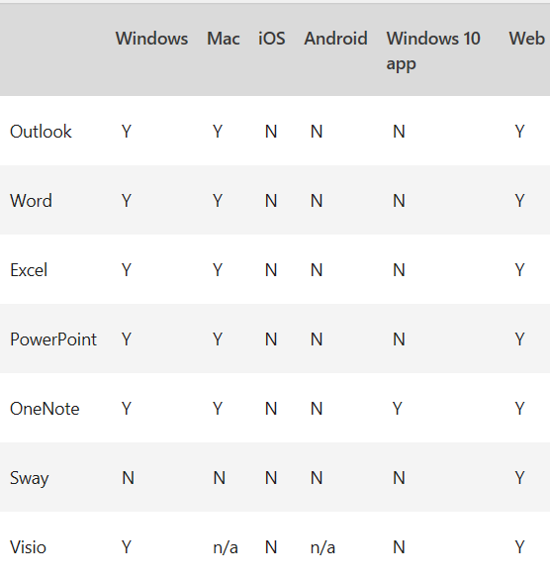
Review → Accessibility
You can turn it on and off
Good Help section
Use the color filter system tool

Slide 3
This is just a preview
Listen to me trying to speak English

Slide 4
1. A pictogram is a chart that uses pictures to represent data.
2. Pictograms can make your data more memorable.
3. Two basic ways to use pictograms

Slide 5


Slide 6
Text one is there!
Text one is there!

Slide 7
Just watch the Lecture :)

Slide 8
Just watch the Lecture :)

